Slide 1
How to sign in?

Slide 2
Step 1: Go to website www.te3health.com
Step 2: Press “My Account”

Slide 3
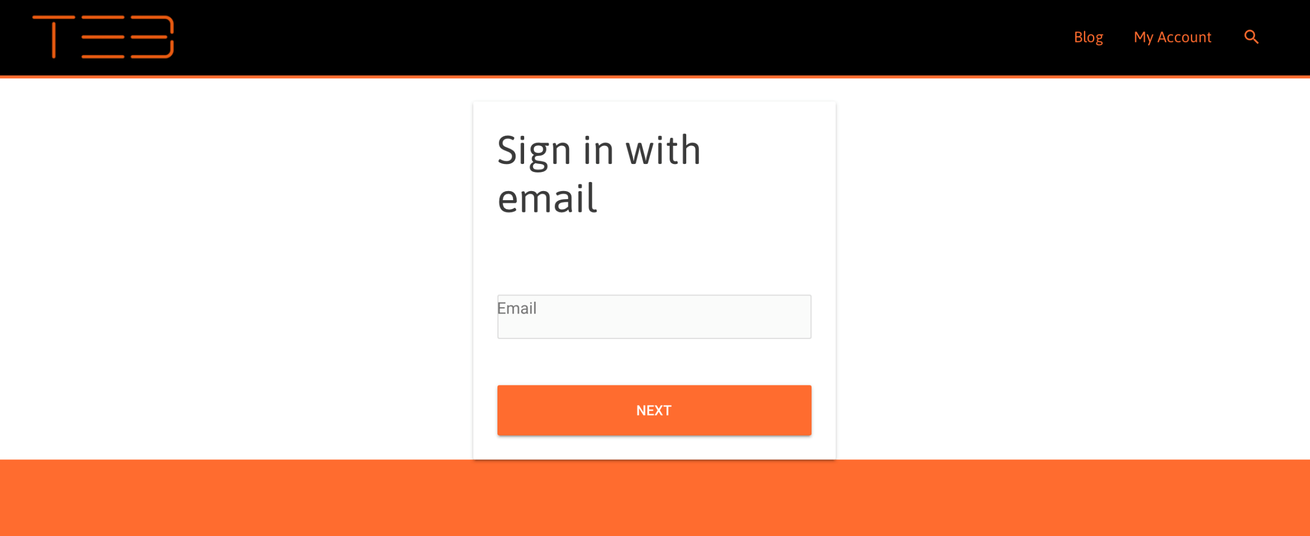
Step 3: Sign your email

Slide 4
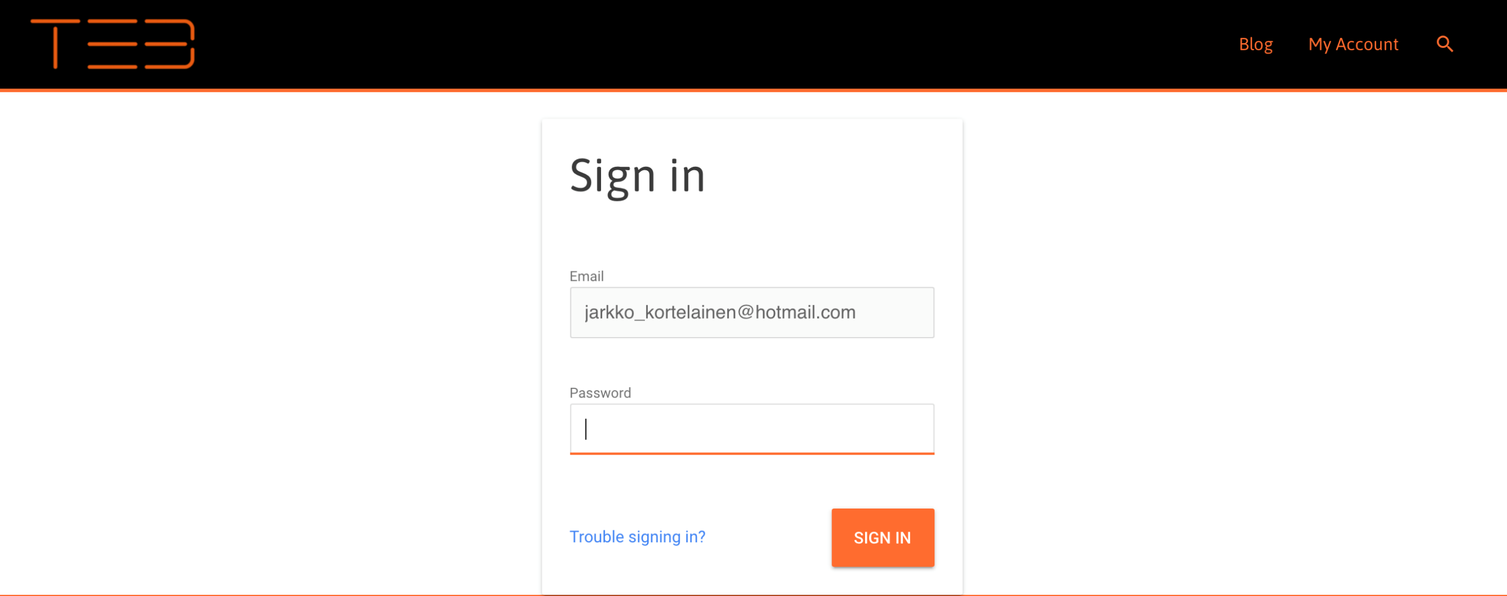
Step 4: Sign your password

Slide 5
Step 5: Press “Redeem a Voucher”
Step 6: Sign your ”Voucher Code” the Voucher code is ModernCoach
Step 7: Press ”My Courses” and start program

Slide 6
www.te3health.com

